Slide 1
Topic proposal
Juan Carlos Reyes Andrade, ICS Draft rev. 2, 2021.01.15

Slide 2
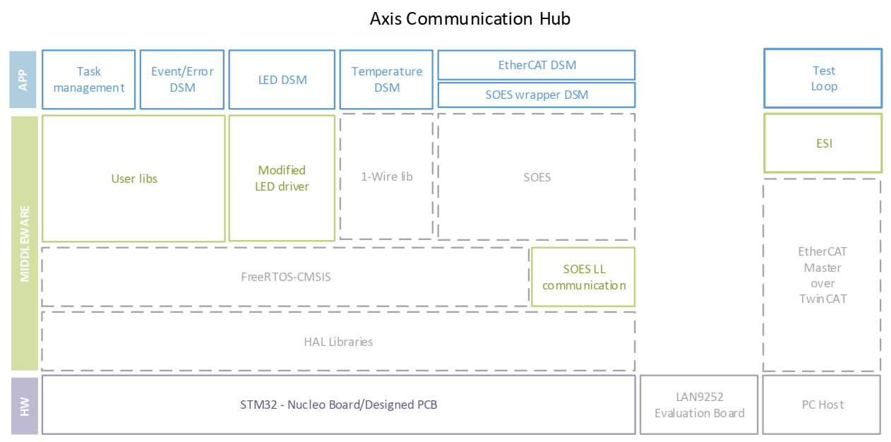
Axis communication hub’s current structure
Highlights: network related tasks, event and command handler and peripheral control-related tasks. The board works within an EtherCAT control network in a 6-Axis Robot.
State machines structured such that they could be verifiable through software, e.g., UPPA (Verification software for FSMs)

Slide 3
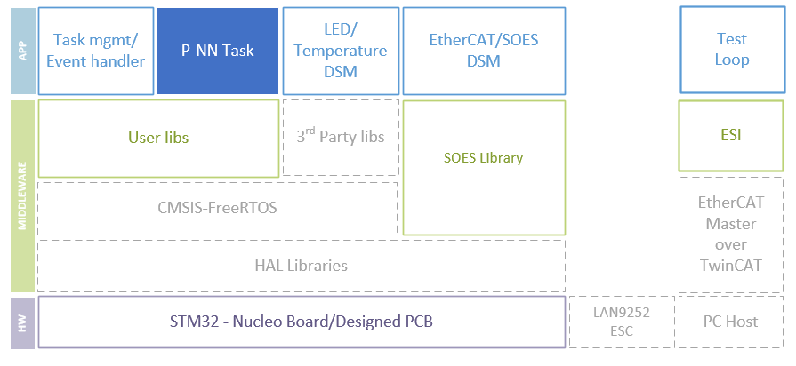
New feature within the structure
Proposed structure with highlighted Neuronal Network running as a task. Other tasks merged only for space reasons.
Highlighted block can be adapted to any functionality. The NN is commonly created out of higher-level tools and would be adapted to current architecture.

Slide 4
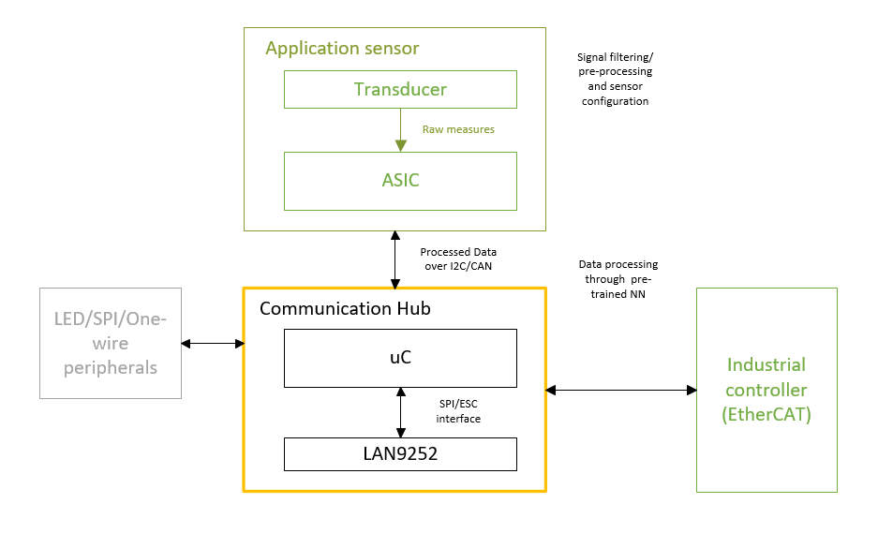
Data flow structure
The proposal assumes high reliability in both the given sensor and the industrial controller.
Whereas the communication hub’s reliability depends on the right execution of its internal features to not affect this reliability chain.

Slide 5
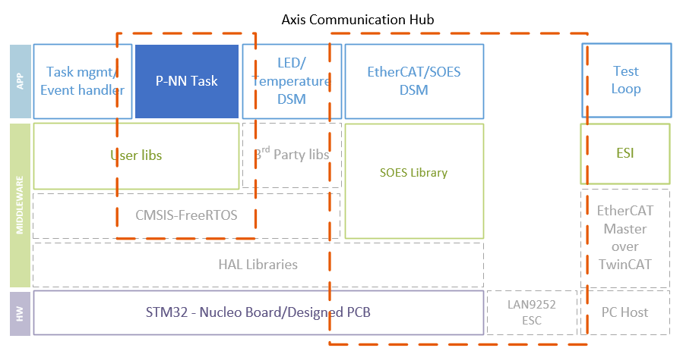
V&V techniques
Verification, validation and testing techniques could be really demanding according to the formality level.
The firmware implementation can be analyzed in parts.
Proposal: the Network-related tasks and the NN-related tasks could be verified separately. Prioritization to one of them would be the focus of the Project.

Slide 6
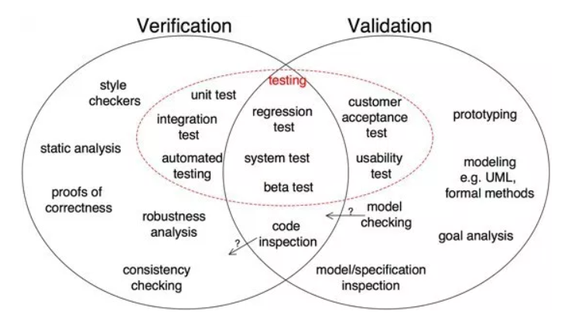
V&V
Validation is concerned with checking that the system will meet the customer’s actual needs, while verification is concerned with whether the system is well-engineered, error-free, and so on.
The following is a set of tools to consider according to the nature of what is going to be validated or verified and the level of formality.

Slide 7
Proposals
All of them rely on 3 main topics
Software for embedded systems, software verification and machine learning.
Possible topics for project depending on the approach and formality of the verification:
Formal verification of NNs (only the NN task)
Verification of FSMs in embedded systems (Network tasks + P-NN as quasi “black box”)
Documentation of dependability analysis according to IEC/IEEE standards (hardware and less software oriented)

Slide 8
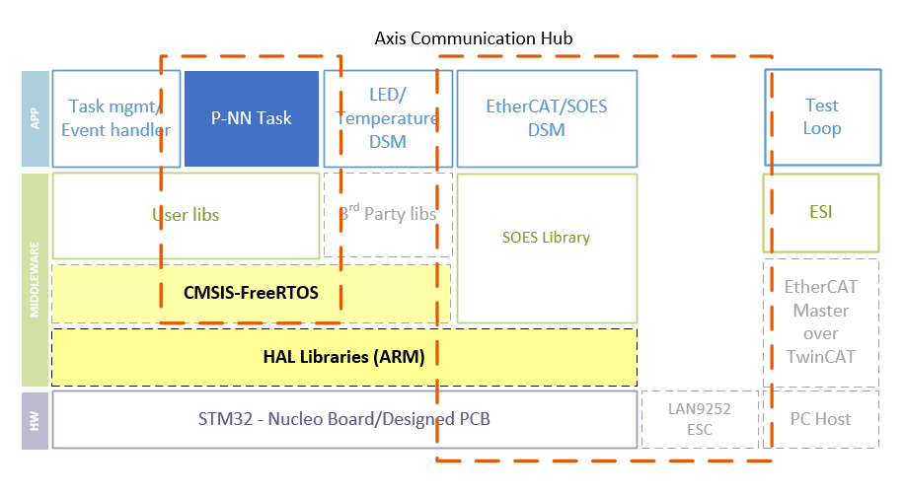
Flexibility of the current structure
Highlighted the tools used during the development of the Axis Communication Hub (Architecture and Operating System)

Slide 9
Further steps:
Go through documentation:
FANNCortexM: An Open Source Toolkit for Deployment of Multi-layer Neural Networks on ARM Cortex-M Family Microcontrollers : Performance Analysis with Stress Detection
CMSIS-NN: Efficient Neural Network Kernels for Arm Cortex-M CPUs
NNV: The Neural Network Verification Tool for Deep Neural Networks and Learning-Enabled Cyber-Physical Systems
Detail the level of formality with someone experienced in NN or machine learning.

Slide 10
Institute of embedded systems at TUHH
Test Optimization for Embedded Systems
Technology-Level Test Vector Generation
Verifying Artificial Neural Networks
Assessing the Performance of Embedded Machine Learning

Slide 11
Institute of embedded systems at TUHH
Test Optimization for Embedded Systems
Embedded systems are not directly visible to the end user. However, they must be extremely reliable to guarantee correct behavior of larger technical systems. For this reason, elaborated test procedures are applied that successively validate each embedded system before shipping. Individual hardware components, electrical interfaces and, finally, the functionality of the complete embedded system including software are incrementally tested. The goal of this work is to work on testing data from a actually running testing process at an industrial partner's facilities in Hamburg.
Technology-Level Test Vector Generation
Test vectors for integrated circuits applied to each produced chip guarantee proper functionality and highest quality standards. More recent improvement in circuit technology and the use of advance approximate processing units makes a precise differentiation of good and bad chips on the logic level more and more difficult. The topic proposed here will consider low-level technology information for generating tests for advanced production processes and approximate hardware.
Verifying Artificial Neural Networks
Formally verifying the correctness of procedures and systems used in safety related areas is a must. Artificial neural networks have been proven very effective in solving many tasks in every day life. However, methods deciding whether an artificial neural network never violates safety guarantees are only at their infancy. The goal of this work is to study the state-of-the-art in verifying correctness of artificial neural networks.
Assessing the Performance of Embedded Machine Learning
Most suppliers of advanced embedded processing devices provide software libraries and hardware support to improve the performance of machine learning in embedded systems either for training classifiers, for applying learned classifiers or both. But how efficient are these embedded platforms. The goal is to use and evaluate the performance of embedded machine learning platforms.

Slide 12
Thank you!

Slide 13
Notes from papers
FANNCortexM: An Open Source Toolkit for Deployment of Multi-layer Neural Networks o ARM Cortex-M Family Microcontrollers [1]
FANN is a free open source neural network library that implements multi-layer ANNs in C. These can be ported and optimized in ARM Cortex-M architectures.
Tested with a 6-input, 3-class perceptron with 2 hidden layers and evaluation of a network with 1000 nodes and 47900 weights (256kB).
Presented process flow: create/obtain dataset, preprocessing, define/train NN, deploy on device.
(Still analyzing)

Slide 14
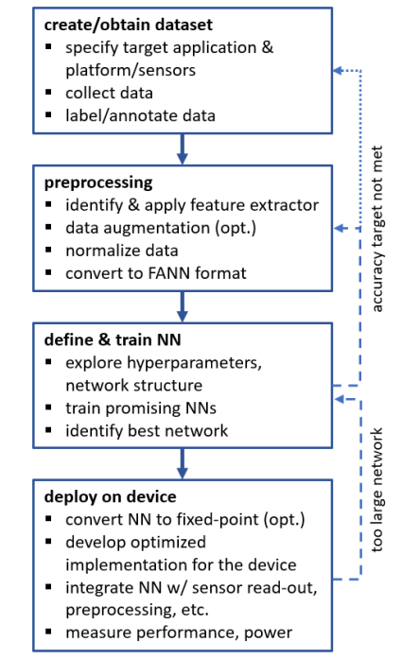
Process flow according to [1]

Slide 15
Proposal 1: details
Implementation of an ANN using FANNCortexM on an Axis Communication Hub to evaluate its performance and usage reliability within an EtherCAT Network.
Use a pre-trained NN with multi-layer perceptrons instead of deep convolutional networks for an application based on a sensor that does not produce images.
According to [1], it will be focused on define/train NN, deploy on device stages, using a given data set at an specific accuracy.
FANN conversion, hyperparametrization, identification of best network, FPU configuration, implementation to HW, measure performance and power.
Current Axis Communication Hub integrates a STM32F446RTE MCU with ARM Cortex-M4 architecture, has FPU and it is within the high-performance family ST processors. 512kB Flash/128+4KB RAM[2].

Slide 16
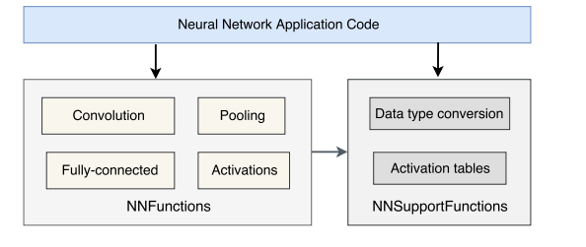
Notes from Papers
CMSIS-NN: Efficient Neural Network Kernels for Arm Cortex-M CPUs[3]
Neural Network Kernel functions structure:
(Still analyzing)

Slide 17
References
[1] M. Magno, L. Cavigelli, P. Mayer, F. v. Hagen and L. Benini, "FANNCortexM: An Open Source Toolkit for Deployment of Multi-layer Neural Networks on ARM Cortex-M Family Microcontrollers : Performance Analysis with Stress Detection," 2019 IEEE 5th World Forum on Internet of Things (WF-IoT), Limerick, Ireland, 2019, pp. 793-798, doi: 10.1109/WF-IoT.2019.8767290.
[2] J. C. Reyes, “Development of an embedded communication hub for sensor data acquisition in a robotic system”, September 2020, Research Project supervised by the Research Group smartPORT of the Hamburg University of Hamburg (TUHH)
[3] Lai L, Suda N, Chandra V. “Cmsis-nn: Efficient neural network kernels for arm cortex-m cpus.” arXiv preprint arXiv:1801.06601. 2018 Jan 19.

Slide 18
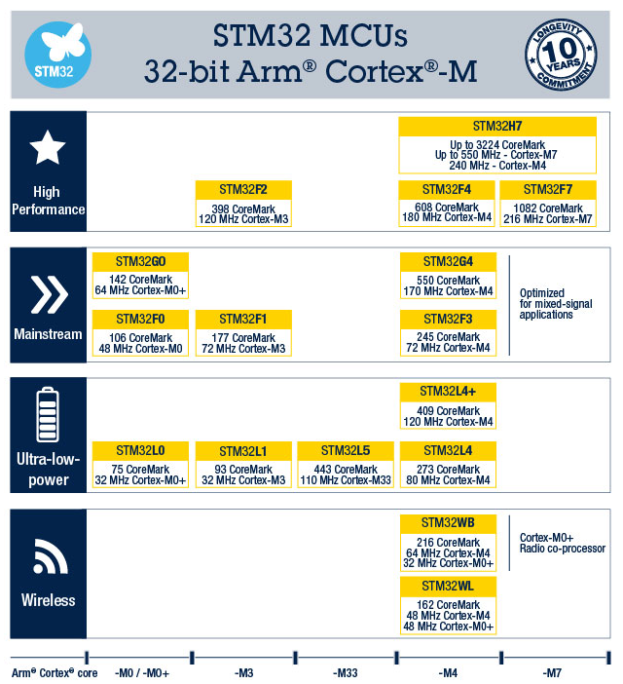
ST Portfolio

Slide 19
DL Compiler list as in [x]
ONNX model file
JIT compilation using:
TVM (tvm.relay.frontend.from_onnx interface)
nGraph (ngraph-onnx Python pckg)
Glow (ONNXModelLoader)
XLA (tensorflow-onnx Python pckg)
TC does not support ONNX files
Target hardware: CPU+GPU no ARM
TVM and Glow support apparently the ARM architecture
Framworks:
TVM: Tensorflow,tflite,keras,pytorch,caffe2,mxnet,coreml,darknet
nGraph:paddlepadde
Notes:
TODO:
Check the compatibility of frameworks.
Are the kernel libraries in the optimization (IR) the ones that should work with CMSIS-NN???
What is the key difference between the training of a NN using JIT or AOT? Is the latter the one tha is going to be downloaded to the MCU??
NOTES about the way of translating the NN
Creation of the computation graph
Vocabulary:
Backend refers to the last translation of a DNN, the one that is specific to the hardware.
Frontend refers to whatever is in the graph model

